Slide 1
Algorithms week 1: Algorithms in Journalism
Jonathan Stray
Columbia Lede Program
July 18, 2018
Notes:
To open: https://mathwithbaddrawings.com/2016/07/13/why-not-to-trust-statistics/

Slide 2
Words <-> numbers

Slide 3
Are there quantitative statements here?
In a country where a sitting congressman told a crowd that evolution and the Big Bang are “lies straight from the pit of hell,” where the chairman of a Senate environmental panel brought a snowball into the chamber as evidence that climate change is a hoax, where almost one in three citizens can’t name the vice president, it is beyond dispute that critical thinking has been abandoned as a cultural value
Anti-Intellectualism Is Killing America, Psychology Today, 23 June 2015
Notes:
https://towcenter.gitbooks.io/curious-journalist-s-guide-to-data/content/quantification/the_quantities_of_everyday.html

Slide 4
Regression

Slide 5
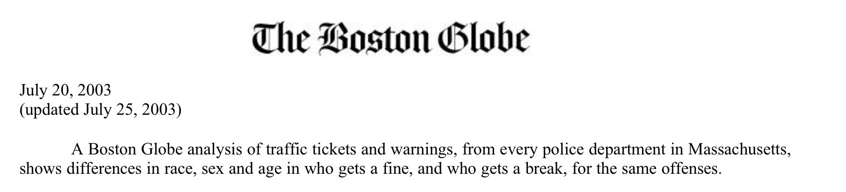
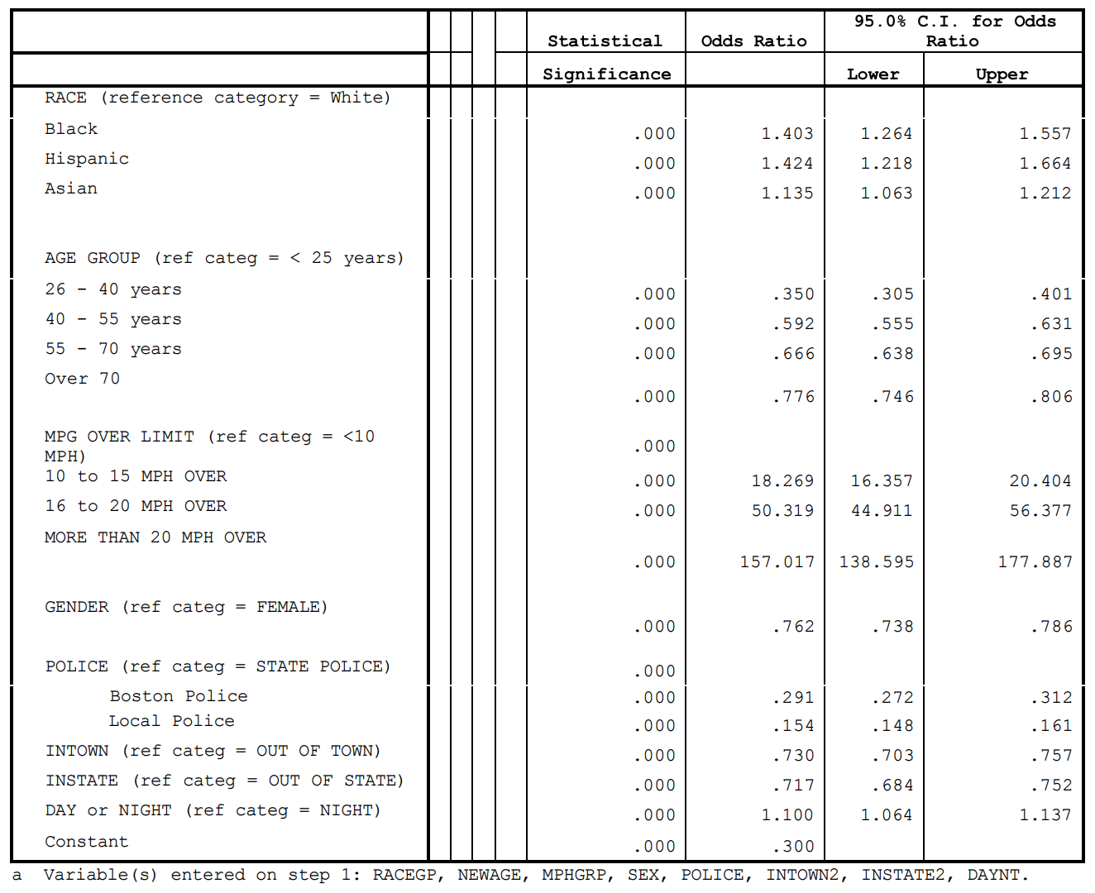
Notes:
http://archive.boston.com/globe/metro/packages/tickets/study.pdf

Slide 6
Text analysis

Slide 7
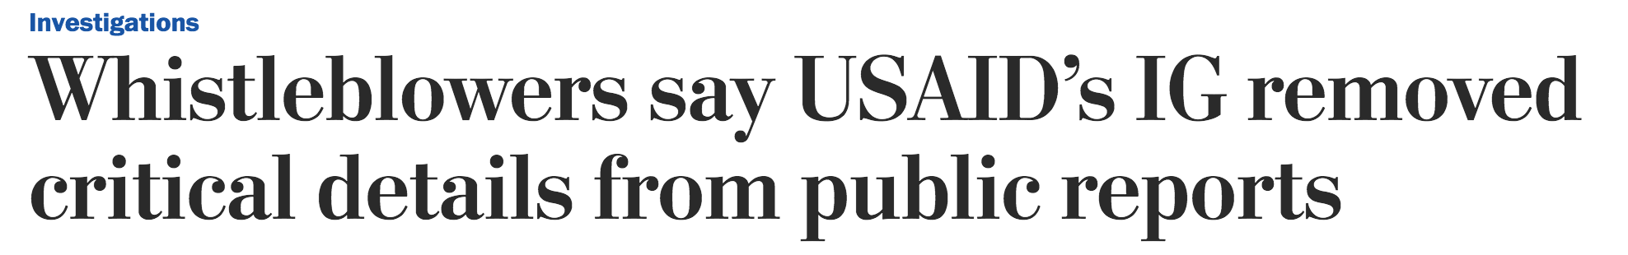
The Post obtained draft versions of 12 audits by the inspector general’s office, covering projects from the Caribbean to Pakistan to the Republic of Georgia between 2011 and 2013. The drafts are confidential and rarely become public. The Post compared the drafts with the final reports published by the inspector general’s office and interviewed former and current employees. E-mails and other internal records also were reviewed.
The Post tracked changes in the language that auditors used to describe USAID and its mission offices. The analysis found that more than 400 negative references were removed from the audits between the draft and final versions.
Sentiment analysis used by Washington Post, 2014
Notes:
https://www.washingtonpost.com/investigations/whistleblowers-say-usaids-ig-removed-critical-details-from-public-reports/2014/10/22/68fbc1a0-4031-11e4-b03f-de718edeb92f_story.html

Slide 8
Technical troubles with a new system meant that almost 70,000 North Carolina residents received their food stamps late this summer. That’s 8.5 percent of the number of clients the state currently serves every month. The problem was eventually traced to web browser compatibility issues. WRAL reporter Tyler Dukes obtained 4,500 pages of emails — on paper — from various government departments and used DocumentCloud and Overview to piece together this story.
https://blog.overviewdocs.com/completed-stories/
Notes:
https://blog.overviewdocs.com/completed-stories/

Slide 9
Overview’s “topic tree” (unsupervised TF-IDF clustering) used to find a group of key emails from a mailing list (Tyler Dukes / WRAL)
Notes:
https://blog.overviewdocs.com/completed-stories/

Slide 10
Machine learning

Slide 11
LAPD Underreported Serious Assaults, Skewing Crime Stats for 8 Years
Los Angeles Times, 2015
Notes:
http://www.latimes.com/local/cityhall/la-me-crime-stats-20151015-story.html

Slide 12
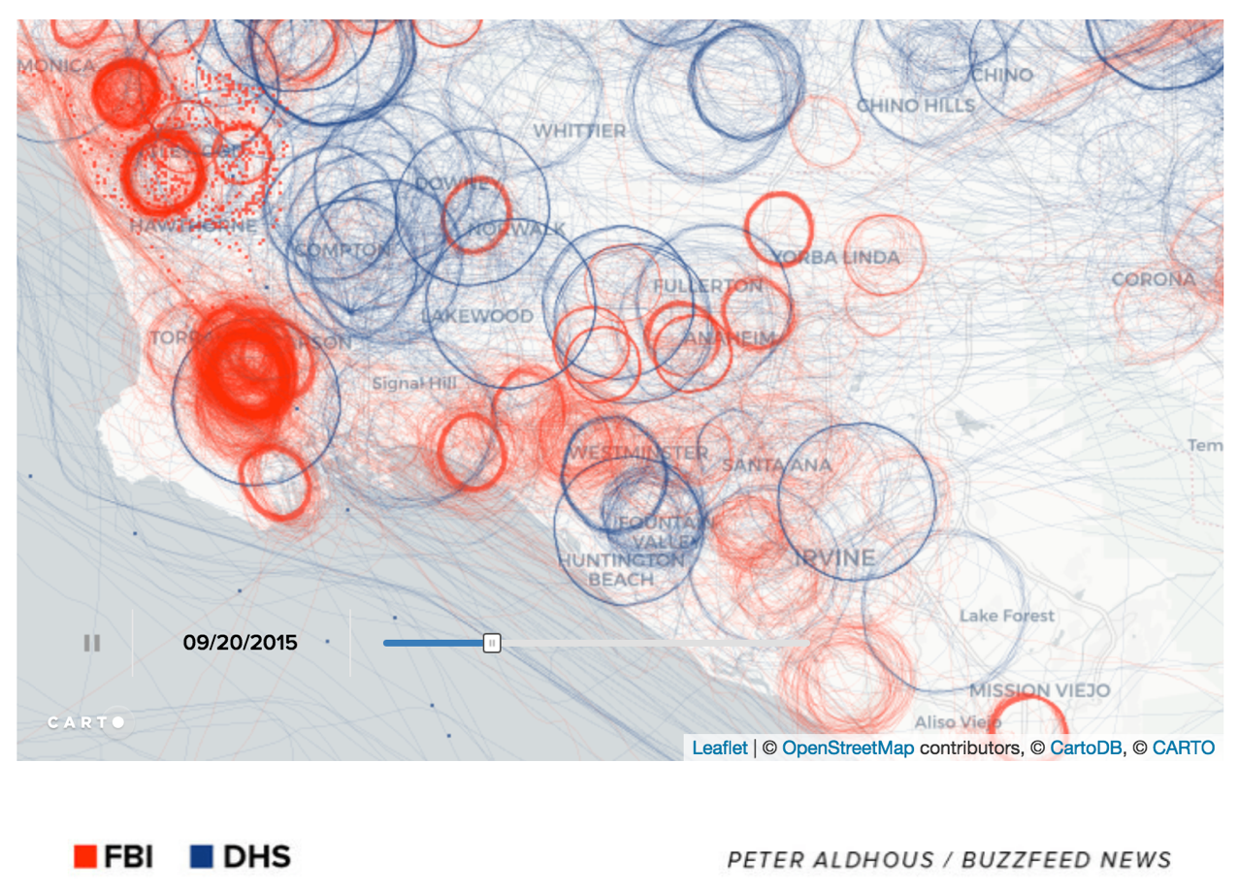
U.S. government surveillance planes identified by machine learning on flight path data (Peter Aldhous/Buzzfeed)
Notes:
https://www.buzzfeed.com/peteraldhous/spies-in-the-skies?utm_term=.taPrVQWez#.hede9d6ZL

Slide 13
Data cleanup

Slide 14
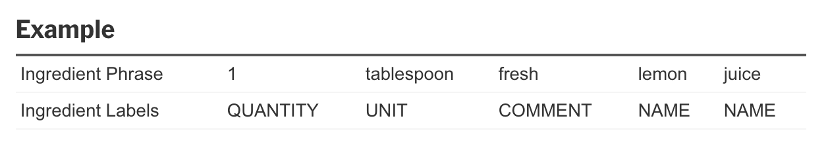
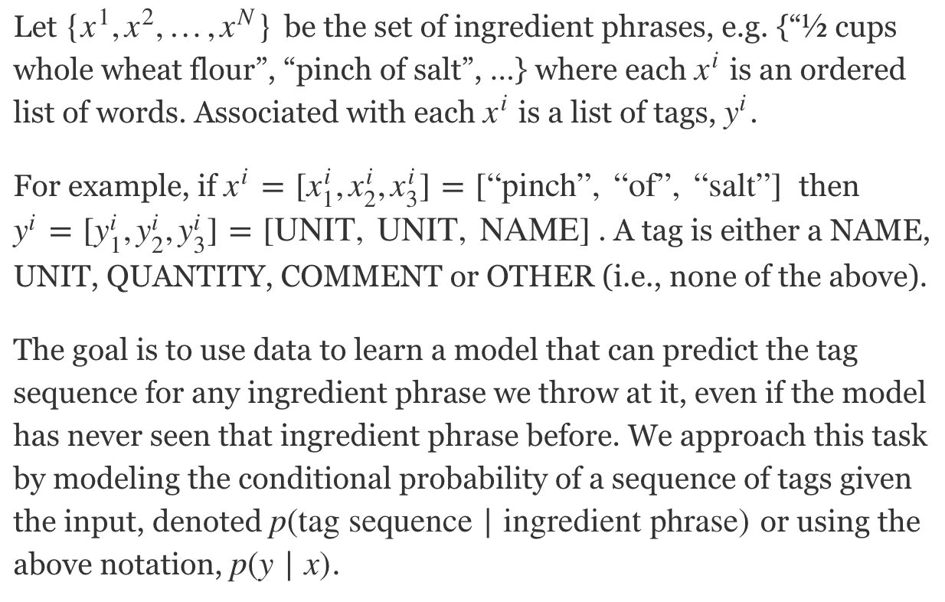
Extracting Structured Data From Recipes Using Conditional Random Fields
Erica Greene, New York Times, 2015
Notes:
http://open.blogs.nytimes.com/2015/04/09/extracting-structured-data-from-recipes-using-conditional-random-fields/

Slide 15
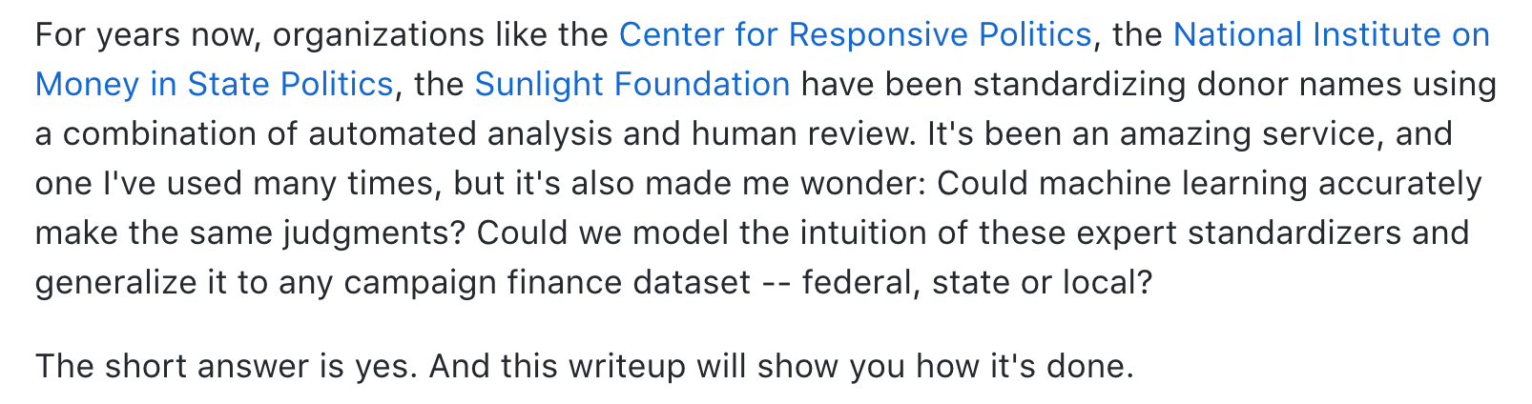
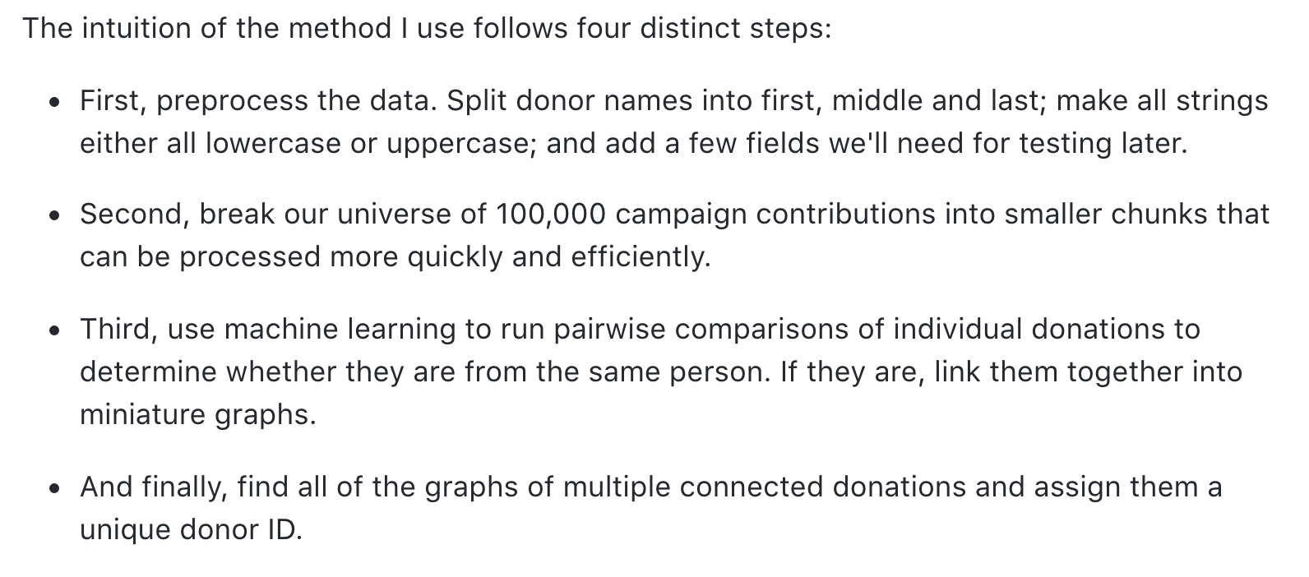
FEC Standardizer, Chase Davis https://github.com/cjdd3b/fec-standardizer/wiki
Notes:
https://github.com/cjdd3b/fec-standardizer/wiki

Slide 16
Simulations

Slide 17
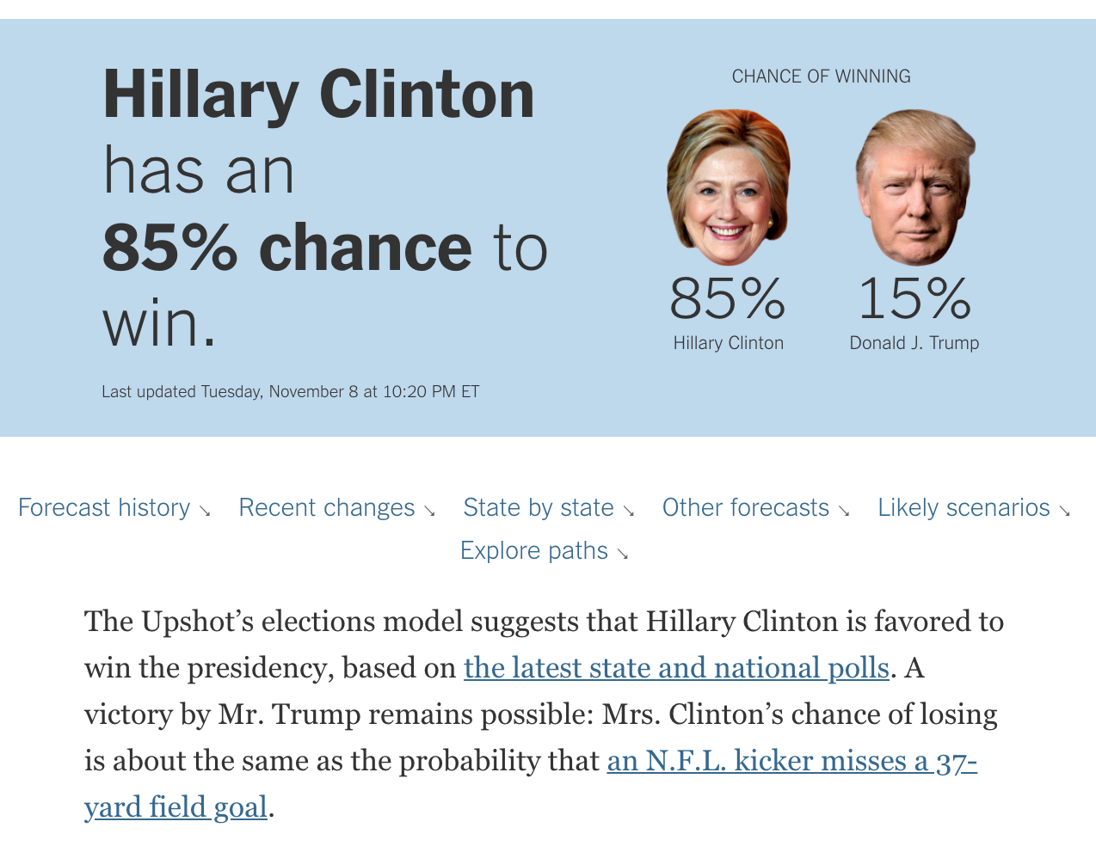
New York Times 2016 Election Predictions
Notes:
https://www.nytimes.com/interactive/2016/upshot/presidential-polls-forecast.html

Slide 18
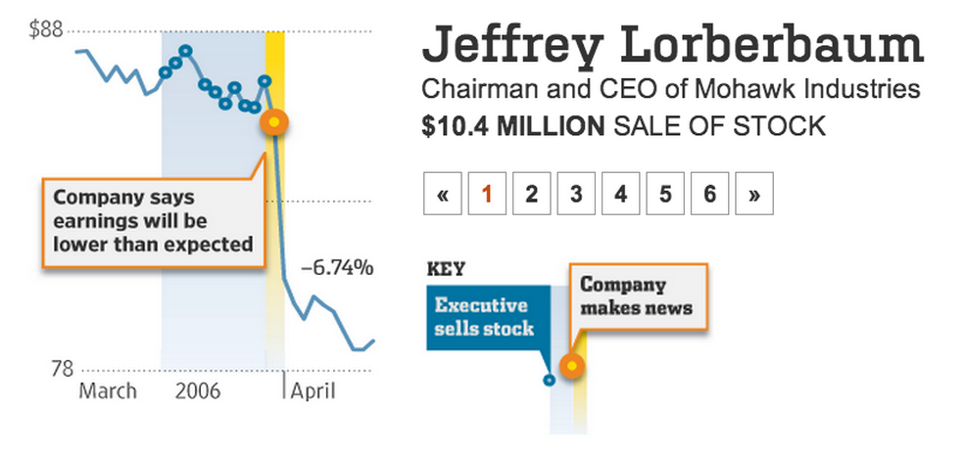
Randomization to detect insider trading
Notes:
http://online.wsj.com/articles/SB10000872396390444100404577641463717344178

Slide 19
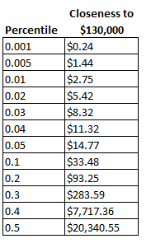
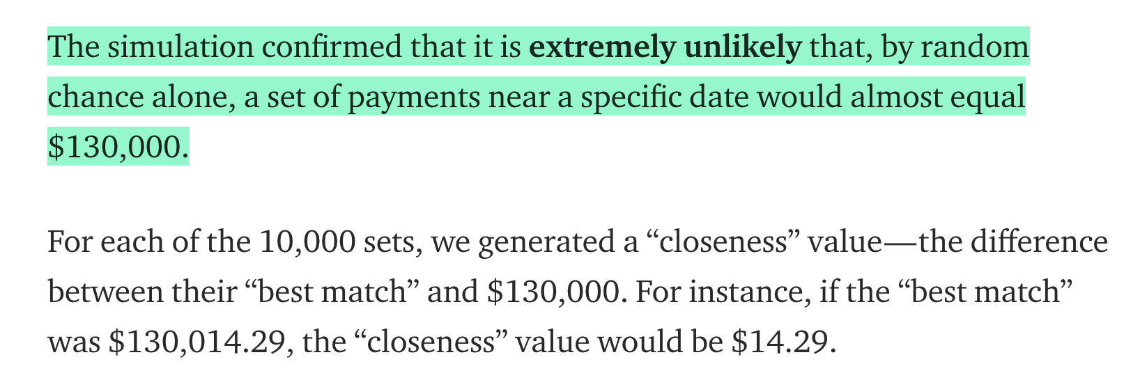
Randomization to detect secret payments?
Statistical Model Strongly Suggests the Stormy Daniels Payoff Came from the Trump Campaign,
Will Stancil
Notes:
https://medium.com/@whstancil/statistical-model-strongly-suggests-the-stormy-daniels-payoff-came-from-the-trump-campaign-7c09c300cb18

Slide 20
Journalism on Algorithms

Slide 21
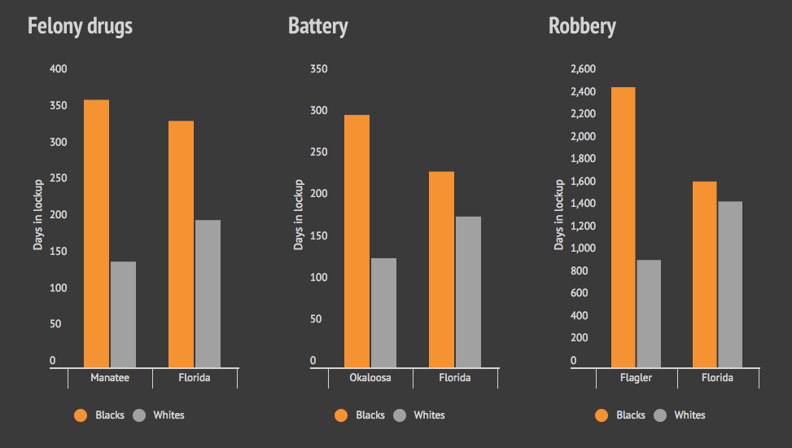
Florida sentencing analysis adjusted for “points”
Bias on the Bench, Michael Braga, Herald Tribune
Notes:
http://projects.heraldtribune.com/bias/sentencing/

Slide 22
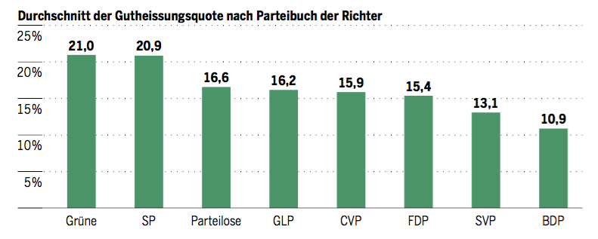
Swiss judges: a natural experiment
24 Judges of Swiss Federal Administrative court are randomly assigned to cases. They rule at different rates on migrant deportation cases. Here are their deportation rates broken down by party.
Barnaby Skinner and Simone Rau, Tages-Anzeiger.
https://github.com/barjacks/swiss-asylum-judges
Notes:
https://github.com/barjacks/swiss-asylum-judges

Slide 23
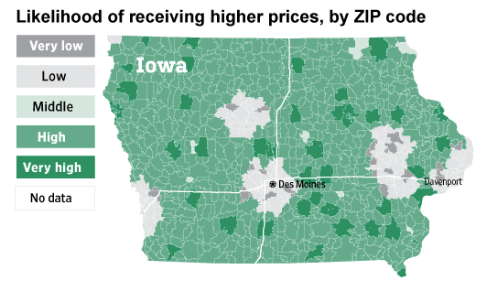
Websites Vary Prices, Deals Based on Users' Information
Valentino-Devries, Singer-Vine and Soltani, WSJ, 2012

Slide 24
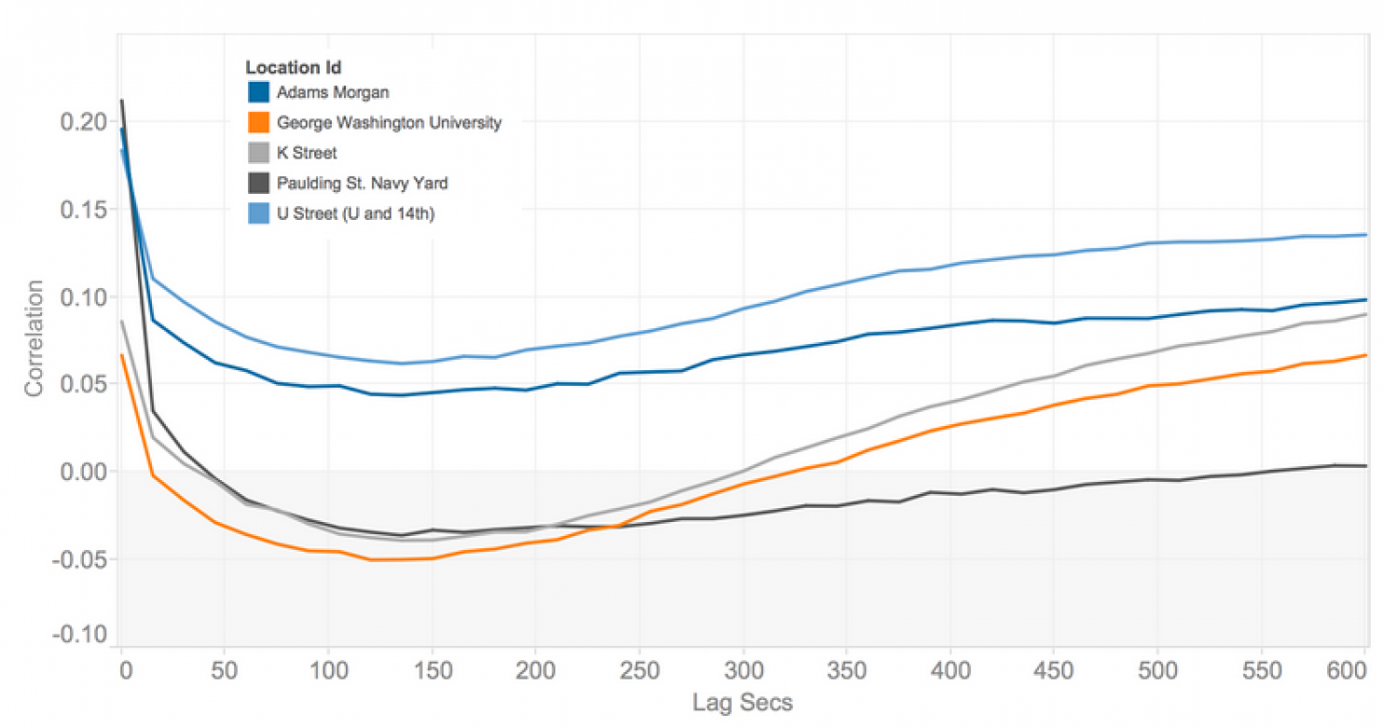
How Uber surge pricing really works, Nick Diakopolous

Slide 25
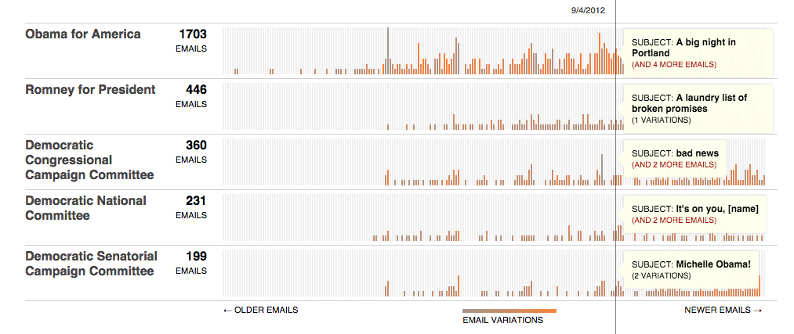
Message Machine
Jeff Larson, Al Shaw, ProPublica, 2012

Slide 26
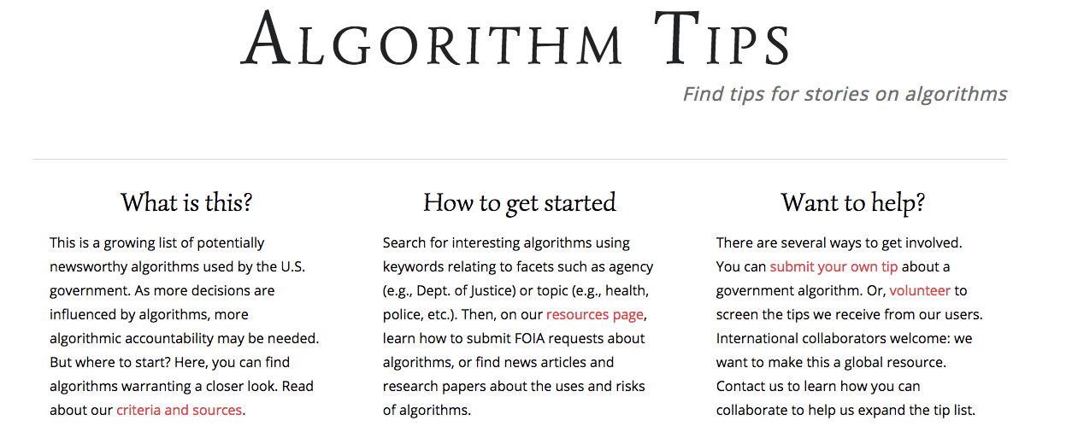
Notes:
http://algorithmtips.org/

Slide 27
Cost of Algorithms:
Time and Space

Slide 28
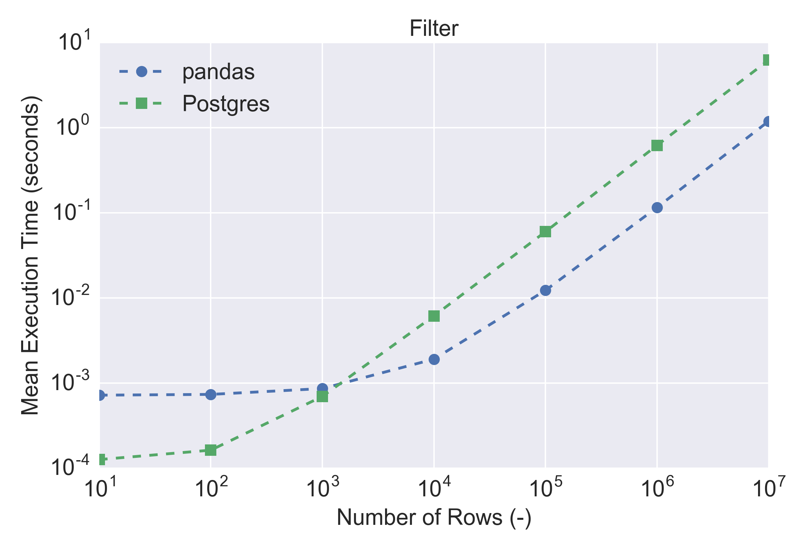
Time cost: How long will your code take to run?
Absolute time and trends vs size.
How many “steps”? What about loops?

Slide 29
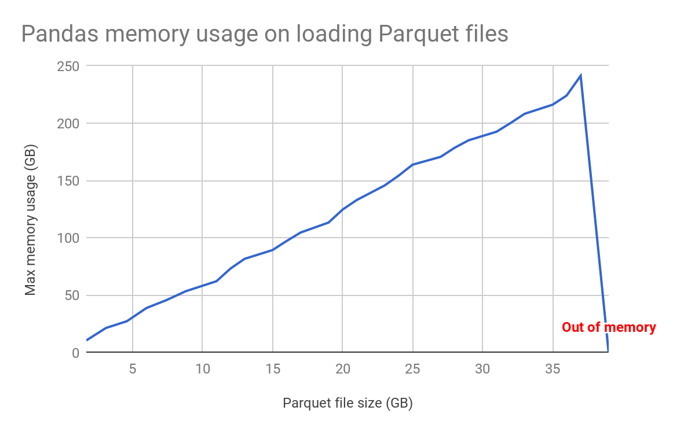
Space cost: memory requirements or file usage
How big is your data? How many bytes to store a dataframe?
How many bytes to store e.g. an image?
Notes:
https://databricks.com/blog/2018/05/03/benchmarking-apache-spark-on-a-single-node-machine.html

Slide 30
An algorithm to find the maximum value
def max(x):
m = x[0]
for i in range (1, len(x)):
if x[i] > m:
m = x[i]
return m

Slide 31
An algorithm to sort a list
def bubbleSort(x):
n = len(x)
# loop over all elements
for i in range(n):
# Last i elements are already in place
for j in range(0, n-i-1):
# Swap if the element j is greater than the next
if x[j] > x[j+1] :
x[j], x[j+1] = x[j+1], x[j]

Slide 32
Why mathematical formalism?

Slide 33
How do you know you’re right?
percent change = (new – old)/old
So what’s the old value, given new and percent change?

